Slide 1
Mouse Interaction
LO: IWBAT to use P5-JS to create a program that requires mouse input.
Notes:
7-8.CT.5
Identify multiple similar concrete
computations in a program, then create a
function to generalize over them using
parameters to accommodate their
differences.

Slide 2
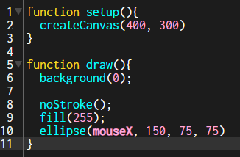
Notice and Wonder
Enter the following code into P5-JS and save as “Mouse”.
What do you notice and wonder about this program?
Notes:
Turn and talk: have students share their responses to each other then to the whole class.

Slide 3
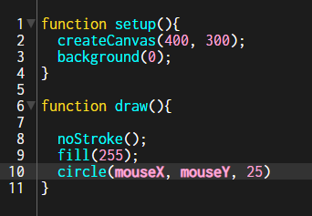
Best Guess
Take a look at the following code without putting it into your editor.
What do you think will happen?
Notes:
Have students write down their guesses then share out. Put responses on the board.
Show students what happens after they all take their guess.

Slide 4
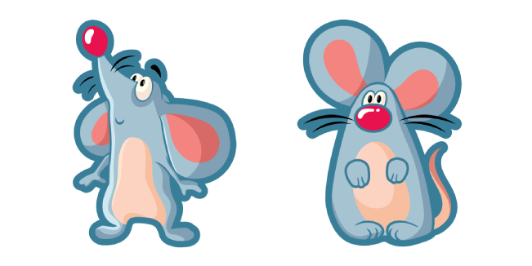
mouseX and mouseY
mouseX
mouseY
The system variable mouseX always contains the current horizontal position of the mouse, relative to (0, 0) of the canvas. The value at the top-left corner is (0, 0) for 2-D and (-width/2, -height/2) for WebGL. If touch is used instead of mouse input, mouseX will hold the x value of the most recent touch point.
The system variable mouseY always contains the current vertical position of the mouse, relative to (0, 0) of the canvas. The value at the top-left corner is (0, 0) for 2-D and (-width/2, -height/2) for WebGL. If touch is used instead of mouse input, mouseY will hold the y value of the most recent touch point.
Notes:
https://p5js.org/reference/#/p5/mouseY
https://p5js.org/reference/#/p5/mouseX

Slide 5
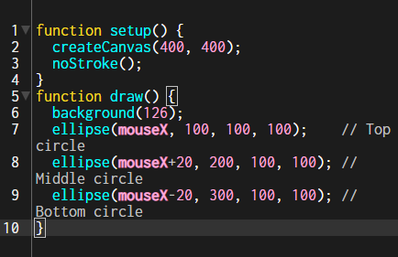
Try This
Run the following program and see what it does. When done, create a program where:
Bottom circle is fastest
Middle circle is slowest
Notes:
Walk around and check if anyone needs help
https://p5js.org/learn/interactivity.html

Slide 6
Exit Ticket
Create a program where when you drag the mouse across horizontally, 2 circles will cross each other perpendicularly.
Notes:
function setup() {
createCanvas(400, 400);
noStroke();
}
function draw() {
background(126);
ellipse(200, mouseX, 100, 100);
ellipse(mouseX, 200, 100, 100);
}

